Slide 1

Internet Programming
Chapter 10​
Secure socket
School of Computer and Software, Shenzhen University

Slide 2
Internet Communications Protection
1. Encryption Fundamentals
Components:
Plaintext, Secret Key, Encryption Algorithm, Ciphertext
Symmetric Encryption (Secret Key):
Same key used for encryption and decryption
Example: AES, DES
Asymmetric Encryption (Public Key):
Key pairs: Public key (shared) and Private key (kept secret)
Used for:
Identity Authentication
Message Integrity Verification
Double Encryption:
Encrypt with:
Your own private key and
Recipient’s public key
2. Security Threats & Mitigations
Man-in-the-Middle (MITM) Attacks:
Prevented via Trusted Third-Party Certificate Authorities (CAs)
CAs store and validate public keys

Slide 3
3. Java Secure Socket Extension (JSSE) Packages
Package | Purpose
javax.net.ssl.SSLSocket | Abstract class for secure socket API
javax.net.ssl.SSLSocketFactory | Abstract factory for creating secure sockets
java.security.cert | Classes for handling SSL public key certificates
com.sun.net.ssl | Implementation-specific classes (Note: Avoid for portability)
// Example: Creating a secure socket
SSLSocketFactory factory = (SSLSocketFactory) SSLSocketFactory.getDefault();
SSLSocket socket = (SSLSocket) factory.createSocket("example.com", 443);

Slide 4
Secure Socket Connection Example
// 1. Get the default SSL socket factory
SSLSocketFactory factory = (SSLSocketFactory) SSLSocketFactory.getDefault();
SSLSocket socket = null;
try {
// 2. Establish a secure connection (default HTTPS port: 443)
socket = (SSLSocket) factory.createSocket(host, port); // Typically port = 443
// 3. Configure cipher suites
String[] supported = socket.getSupportedCipherSuites();
socket.setEnabledCipherSuites(supported); // Enable all supported suites
// 4. Get I/O streams for secure communication
InputStream in = socket.getInputStream();
OutputStream out = socket.getOutputStream();
// ... Read/write data as usual ...
} catch (IOException e) {
System.err.println("SSL connection failed: " + e.getMessage());
} finally {
// 5. Gracefully close the socket
if (socket != null) {
try { socket.close(); }
catch (IOException e) { /* Log error if needed */ }
}
}

Slide 5
Creating a Secure Client Socket
SSLSocketFactory - Secure Socket Factory Class
http://docs.oracle.com/javase/8/docs/api/javax/net/SocketFactory.html
Inheritance: Extends javax.net.SocketFactory (base class for socket factories).
SSLSocket
http://docs.oracle.com/javase/8/docs/api/javax/net/ssl/SSLSocket.html
Method | Description
static SocketFactory getDefault() | Returns the default socket factory (typically an SSLSocketFactory instance).
Socket createSocket() | Creates an unconnected socket.
abstract Socket createSocket(InetAddress host, int port) | Creates a socket connected to the specified host:port.
abstract Socket createSocket(String host, int port) | Creates a socket connected to the named host and port.
abstract Socket createSocket(InetAddress address, int port, InetAddress localAddress, int localPort) | Creates a socket with explicit local binding.
abstract Socket createSocket(String host, int port, InetAddress localHost, int localPort) | Creates a socket with named remote host and local binding.
Client example ex10-1 HTTPSClient using secure socket , the program uses secure socket to connect to a secure server (United States Postal Service www.usps.com ), send a simple GET request and respond.

Slide 6
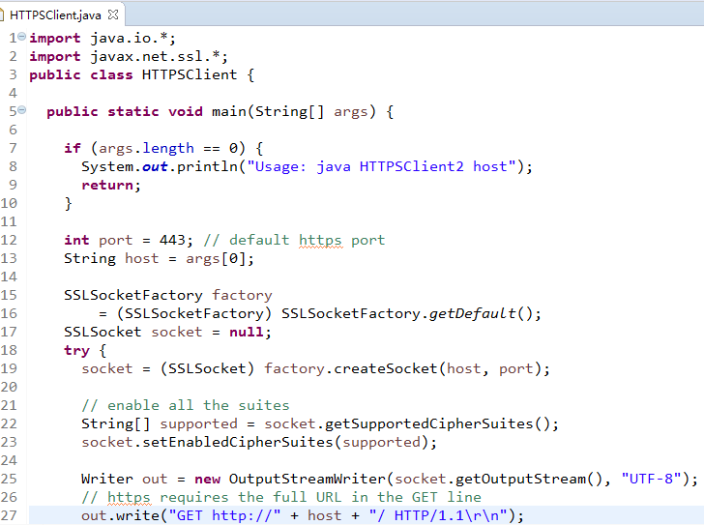
Client Example Ex10-1 HTTPSClient using secure socket , the program uses secure socket to connect to a secure server (United States Postal Service www.usps.com ), send a simple GET request and respond.
https://www.usps.com/

Slide 7
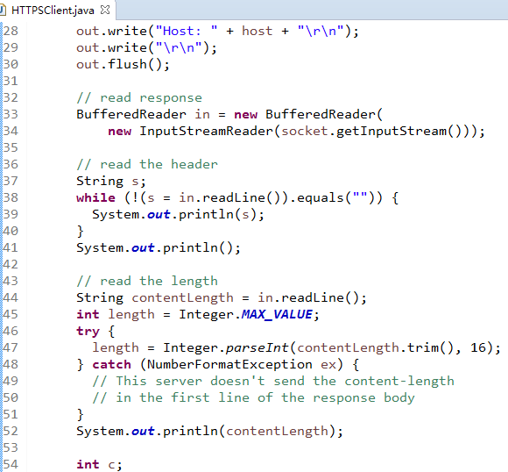

Slide 8
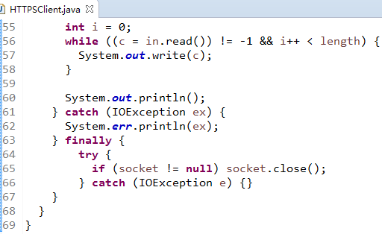
Client example ex10-1 HTTPSClient using secure socket , the program uses secure socket to connect to a secure server (United States Postal Service www.usps.com ), send a simple GET request and respond.

Slide 9
SSLSocketFactory Class Methods
1. Key Methods
Method | Description
abstract String[] getSupportedCipherSuites() | Returns all cipher suites available on the JVM/SSL implementation.
abstract void setEnabledCipherSuites(String[] suites) | Overrides the default cipher suites the client will attempt to use for SSL/TLS handshakes.
2. Cipher Suite Naming Convention (JDK 1.7+): Each cipher suite name follows a 4-part structure:
Protocol_KeyExchange_Encryption_HashAlgorithm
Example:
TLS_ECDHE_ECDSA_WITH_AES_128_CBC_SHA256

Slide 10
Component | Description
TLS | Transport Layer Security (successor to SSL, standardized by IETF).
ECDHE | Elliptic Curve Diffie-Hellman Ephemeral: Key exchange using Elliptic Curve Cryptography (ECC), providing forward secrecy.
ECDSA | Elliptic Curve Digital Signature Algorithm: Used for authentication.
AES_128_CBC | Encryption: 128-bit Advanced Encryption Standard in Cipher Block Chaining mode.
SHA256 | Hash: 256-bit Secure Hash Algorithm for message integrity.
3. Protocol Background
TLS vs SSL:
TLS is the modern, standardized version of SSL (SSL 3.0 → TLS 1.0, 1.2, 1.3).
SSL is deprecated due to vulnerabilities (e.g., POODLE).
Key Exchange (ECDHE):
Uses Elliptic Curve Cryptography (ECC) for secure key exchange over untrusted networks.
Provides forward secrecy: Compromised keys won’t decrypt past sessions.
Encryption (AES_CBC):
AES-128: 128-bit symmetric encryption (stronger than legacy DES).
CBC Mode: Cipher Block Chaining prevents pattern analysis.
Hash (SHA256):
Generates a 256-bit message digest for data integrity.
More secure than SHA-1 or MD5.

Slide 11
4. Usage Example
SSLSocketFactory factory = (SSLSocketFactory) SSLSocketFactory.getDefault();
SSLSocket socket = (SSLSocket) factory.createSocket("example.com", 443);
// Get supported cipher suites
String[] supported = factory.getSupportedCipherSuites();
// Restrict to secure suites only
String[] enabledSuites = {
"TLS_ECDHE_ECDSA_WITH_AES_128_GCM_SHA256",
"TLS_ECDHE_RSA_WITH_AES_128_GCM_SHA256"
};
socket.setEnabledCipherSuites(enabledSuites);
5. Security Recommendations
a. Prioritize Modern Ciphers:
// TLS 1.2/1.3 with forward secrecy
setEnabledCipherSuites(new String[] { "TLS_ECDHE_ECDSA_WITH_AES_256_GCM_SHA384", "TLS_ECDHE_RSA_WITH_AES_256_GCM_SHA384" });
b. Disable Weak Protocols:
socket.setEnabledProtocols(new String[] {"TLSv1.2", "TLSv1.3"});
c. Avoid: SSLv3, TLS 1.0/1.1
Ciphers with NULL, EXPORT, or DES in their names.

Slide 12
Client Mode
Secure Internet communications require a server certificate to authenticate itself.
Clients usually do not need to authenticate themselves. To require clients to authenticate themselves, use:
setUseClientMode(boolean mode)
Determines whether the socket needs to use authentication during the initial handshake
If the server requires all clients connecting to it to authenticate, you can do so by
public abstract void setNeedClientAuth(boolean needsAuthentication) to set

Slide 13
Steps for Creating a Secure Server Socket
Generate a public key and certificate using keytool.
Get the certificate signed/verified by a trusted Certificate Authority (CA).
Initialize an SSLContext for the desired cryptographic algorithm (e.g., TLS).
Create a TrustManagerFactory to manage trusted certificates (e.g., CA roots).
Create a KeyManagerFactory to handle the private key and certificate chain.
Instantiate a KeyStore object to securely store key material and certificates.
Load the KeyStore with the private key, certificate chain, and trusted CA entries.
Initialize the KeyManagerFactory with the KeyStore and its passphrase.
Configure the SSLContext with:
Key managers (from KeyManagerFactory),
Trust managers (from TrustManagerFactory),
A cryptographically secure random number generator.
Key Terms:
keytool – Java key and certificate management tool.
SSLContext – Configures SSL/TLS security settings.
TrustManagerFactory – Manages trusted certificates (e.g., CA certs).
KeyManagerFactory – Manages private keys and certificates for authentication.
KeyStore – Secure storage for cryptographic keys and certificates.
This process sets up secure communication (e.g., HTTPS) in Java applications.

Slide 14
Creating a secure server socket
SSLServerSocket
http://docs.oracle.com/javase/8/docs/api/javax/net/ssl/SSLServerSocket.html
SSLServerSocket objects are created through SSLServerSocketFactory, similar to SSLSocket
Secure Server Socket Example (Ex10-2 SecureOrderTaker)
This program accepts orders and displays them in the console output.
2. Prerequisite:
First, use the keytool utility provided with the JDK to generate the jnp4e.keys file.
The keystore password should be: 2andnotafnord
3. Command:
keytool -genkey -alias ourstore -keystore jnp4e.keys

Slide 15
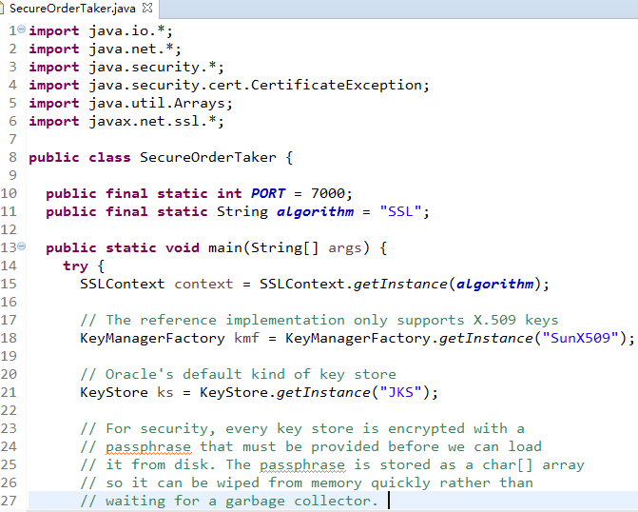

Slide 16
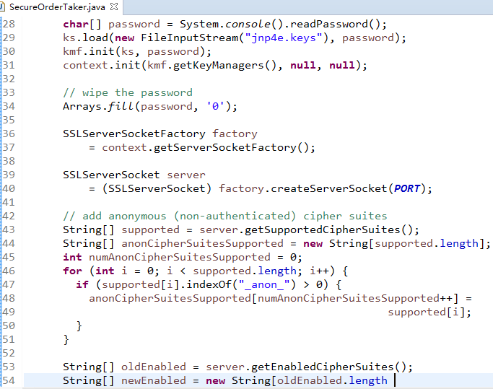

Slide 17
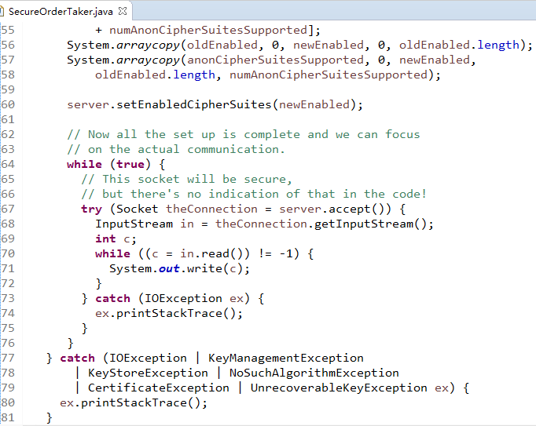


Slide 18
Configuring SSLServerSocket
The SSLServerSocket class provides dedicated methods for the following configurations:
1. Cipher Suite Selection
// Returns all supported cipher suites
public abstract String[] getSupportedCipherSuites()
// Returns currently enabled cipher suites
public abstract String[] getEnabledCipherSuites()
// Sets enabled cipher suites (e.g., restrict to TLS_ECDHE_* for forward secrecy)
public abstract void setEnabledCipherSuites(String[] suites)
2. Session Management
// Controls whether new SSL/TLS sessions may be established
public abstract void setEnableSessionCreation(boolean allowSessions)
// Checks if session creation is permitted
public abstract boolean getEnableSessionCreation()

Slide 19
3. Client Authentication Mode
Configures whether clients must authenticate themselves to the server:
// Enforces client certificate authentication when true
public abstract void setNeedClientAuth(boolean flag)
// Returns current client authentication requirement
public abstract boolean getNeedClientAuth()

Slide 20
Thanks

